Slide 1

The CE Planning Office and Installation Development Plan
By:
Terry Landreth, PE
CE Planning Office Supervisor
Aug 2015
" The Installation of Excellence...The Place to Live, Learn, Work and Play"
Notes:
Hello. My name is Terry Landreth and I am the Supervisor for the CE Planning Office.

Slide 2
Overview
The CE Planning Office
What is Planning at the Base Level?
The Installation Development Plan
“The Installation of Excellence … The Place to Live, Learn, Work and Play”
Notes:
The three basic topics I would like to present, include an Overview of the CE Planning Office, a quick look at what is the scope of “Planning” at the Base Level and then take a look at the recently completed Installation Development Plan, its contents and what it provides to the Planning effort.

Slide 3
Simplified CEG Organization
78 CEG
CEG Executive Staff
Installation Management Division
778 CES Emergency Services
78 CES Operations
Engineering Division
“The Installation of Excellence … The Place to Live, Learn, Work and Play”
Notes:
The planning Office is a part of the Engineering Division in the 78th Civil Engineer Group

Slide 4
Planning Organization
CE Planning Supervisor
Landreth
Community Planning
Space Planning
Hinton
Saffold/Howard
Airfield Planning
Planning Support
Allen
Grills/Robinson
“The Installation of Excellence … The Place to Live, Learn, Work and Play”
Notes:
And within the Planning Office there are four main responsibilities

Slide 5
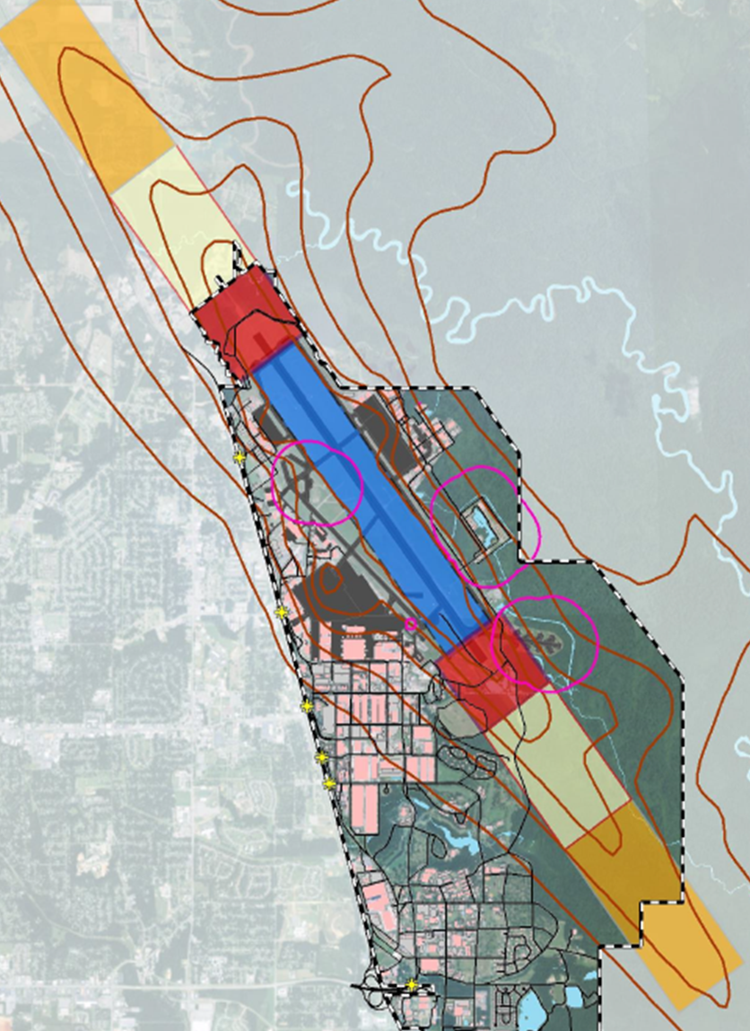
The CE Planning Office
Space Planning
  Manage Admin Space
  Space Audits
Airfield Planning
  Ensure a Safe & Operational Airfield
  Temporary Construction Waivers
  Plan Projects
Planning Support
  Field Surveys and Documents
  Unit Support
Community Planning
  Land Use Planning
  Encroachment Management
Notes:
First, I would like to talk about the space office. We manage mainly the Administrative space on base. We typically do that in response to a need or mission requirement. We do have the responsibility to locate space for organizational growth, make recommendations for consolidations and help folks plan moves as mission change. In order to manage spaces effectively, we conduct space audits. We are looking for vacancies, unused or improperly used spaces and occupant organizations.
Another item in our basket of responsibility is the Airfield. We focus on the physical asset, the pavement, the lights, physical obstructions, etc. Whenever there are construction projects that occur in the area of the airfield, a Temporary Construction Waiver request is made. In order to have a TCW approved by the Installation Commander, specific safety reviews are performed and mitigation plan is prepared to ensure any risk to Airfield operations and safety has been noted and addressed. The airfield is frequently inspected and specialized condition assessments are made periodically. The findings of these feed into our plans for projects that are required to maintain the airfield in prime operational condition. These efforts have paid off. Our airfield is typically rated among the best airfields in the Air Force. This is the result of great team work that comes from frequent coordination with all the affected parties and management priorities.
Our planning support responsibilities address those task that support all the other area as well as picking up those miscellaneous tasks that always exist in every organization. These technicians make this happen. They help create the documents, maps and drawings that are needed by our mission. They also assist the entire division with our Safety and Security programs and Facility Management.
I deliberately have saved Community Planning for last as it feeds into my overview of Planning and the Installation Development Plan.
There are two main tasks performed by Community Planning. The first is to ensure new facilities are sited or located in an appropriate place. It is the job of the community planner to ensure all requirements for new facilities are sited in functionally compatible areas and that any potential land use constraints are avoided. Some of the constraints would include aircraft clearances, environmental concerns, and safety.
The next major task of the Community Planner is to serve as the Point of Contact for Encroachment Management issues. Encroachment Management is the process of minimizing the impact of the base on the community and the community on the base. In the past encroachment has been limited to the clearances required for airfield operations known as Air Installation Compatible Use Zones or AICUZ but in the past few years, this definition of Encroachment has been expanding. It now includes impacts of one mission to another and all the areas of base and community interactions and includes, traffic, storm water, environmental issues and many other areas.

Slide 6

What is Planning?
“The Installation of Excellence … The Place to Live, Learn, Work and Play”
Notes:
Right Now, I wish to touch on briefly what I see as Base Level Planning. Many people think that planning involves an answer to the question, “What will the Base Look like 50 years from now?” Other than pretty much like it does now, I can not say. Many factors affect the overall Mission of Robins AFB. The needs of the Air Force, Congressional Funding and Vision, changes in Technology, Changes in threats and our response.

Slide 7
What is Planning?
No Crystal Ball for Future Configuration or Mission
“The Installation of Excellence … The Place to Live, Learn, Work and Play”
Notes:
All of these considerations occur at much higher levels than here at Robins and I have no crystal ball to see what changes may be included in the next 50 years or how the funding will move to bring about those changes.
Well if our vision is so limited, what is there left to base level planning? How can we “plan” at all?

Slide 8
What is Planning?
No Crystal Ball for Future Configuration or Mission
Requirement and Opportunity Planning
“The Installation of Excellence … The Place to Live, Learn, Work and Play”
Notes:
There is a lot of room for planning with what I refer to as Requirement and Opportunity Planning. What are the requirements for our current mission, what is needed to maintain and improve our base assets, what opportunities can the base offer to it’s current mission partners and what capabilities do we have for higher Air Force to consider when they do planning at their level.

Slide 9
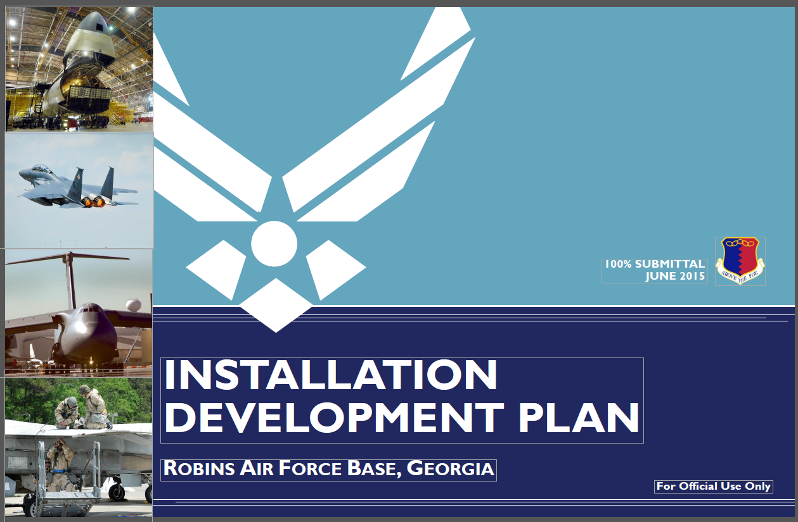
Installation Development Plan
Notes:
With that idea of Planning in mind, we have a tool that brings most of the planning criteria into one place.
Welcome to the Installation Development Plan.

Slide 10
Installation Development Plan
The Installation Development Plan (IDP) is required by AFI 32-7062.
  Michael Baker Jr., Inc. was hired to develop the IDP
  Initial visit was March 2014
  Visioning workshop was held June 2014
  Final was delivered June 2015
Most Mission Partners and ABW organizations participated in review process
Scope included Mission Statement Alignment, Planning Constraints, Installation Capacity Opportunities, and Future Planning.
https://org.eis.afmc.af.mil/sites/78abw/78ceg/CEN/CENPL/Community%20Planning%20IDP/IDP_RAFB_100_Percent.pdf
“The Installation of Excellence … The Place to Live, Learn, Work and Play”
Notes:
The Installation Development Plan or IDP is a required document and our current version was developed by a contractor on behalf of the Air Force. The effort started in 2014 and the Final was received this past June. We are pleased with the support we received from our mission partners and staff agencies during the contractor’s fact finding stage and during the reviews that were requested. In general the IDP addresses the alignment of our plans with the Air Force mission, the existing conditions on the base and opportunities for the future.
For those on base, the IDP is found at the link shown here. For those that are not on base, this document is mark For Official Use Only so there are some restrictions on what can be disseminated. If you have some specific question, please feel free to contact me and I’ll see what I can do.

Slide 11
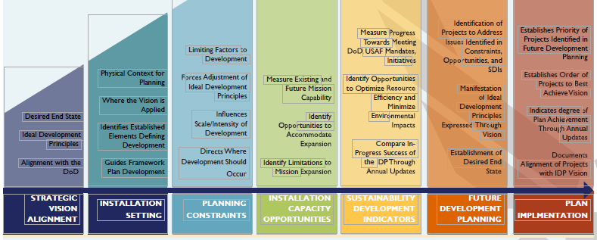
IDP Overview
“The Installation of Excellence … The Place to Live, Learn, Work and Play”
Notes:
These are the main sections of the IDP . In case they are not shown clearly, they are the
Strategic Vision Alignment
Installation Setting
Planning Constraints
Installation Capacity Opportunities
Sustainability Development Indicators
Future Development Planning
And
Plan Implementation

Slide 12
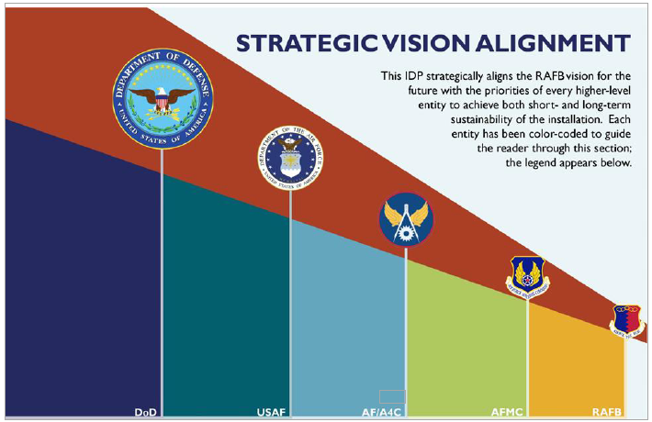
IDP Alignment
“The Installation of Excellence … The Place to Live, Learn, Work and Play”
Notes:
For the Strategic Alignment, the vision of the DoD, Air Force, the AF Civil Engineer, the Air Force Materiel Command and Robins AFB were all examined to ensure that any planning effort would be in step with the overall direction desired.

Slide 13
Current State
Robins AFB is Home for:
  Headquarters of the Air Force Reserve Command
  Warner Robins Air Logistic Complex (WR-ALC)
  78th Air Base Wing
  A Regional Center for the Defense Logistics Agency (DLA)
  5th Combat Communications Group
  The Air Force and Air National Guard JSTARS Wings
  Over 30 Mission Partners
Robins AFB has:
  Over 23,000 military and civilian employees
  Over 4.3 million square feet of shop and hangar space
  Largest industrial facility in the state of Georgia
  2nd Longest runway in Georgia - 12,001 feet long and 300 feet wide
“The Installation of Excellence … The Place to Live, Learn, Work and Play”
Notes:
Next the IDP looks at the existing state of Robins AFB and its capabilities. Most of these facts have been seen before but I wish to point out one. Prior to 2010, Robins AFB had the longest Runway in Georgia. After 2010, Atlanta-Hartsfield International added 500 feet to their longest runway and they now hold the to top honor for Runway size but we are still hanging in at the top.

Slide 14
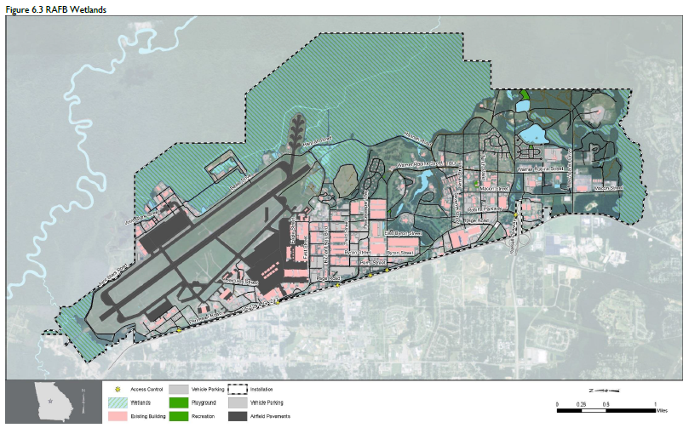
Notes:
Next, the IDP addresses those items that have an impact on how we use the land available to use. Anything that places a restriction on the use of a parcel of land is called a constraint. Wetlands and environmental concerns provide a large number of restrictions on how and if we can us a parcel of land. Archeological and historical concerns were also identified. There are also issues of clearances for security and safety, operational clearances such as aircraft wing clearances, clearances and restrictions due to hazardous or explosive substances.
This chart here provides a view of some of the wetland constraints and….

Slide 15

Notes:
This chart here indicates some of the noise and operational restrictions that exist due to airfield operations.

Slide 16
Existing Conditions and Growth Capacity
Existing Conditions:
  Green: Meets Current Operational Requirements and Standards
  Yellow: Meets operational minimums but is in need of upgrade or does not meet current standards.
  Red: Does not meet current minimums. Mission is compromised
Growth Capacity:
  Green: Able to meet increased demand without significant upgrades or additions
  Yellow: Upgrading and expansions are required to meet future growth
  Red: Unable to meet any increase in demand without significant upgrades, additions or replacements
“The Installation of Excellence … The Place to Live, Learn, Work and Play”
Notes:
Since we are involved in requirement planning, the IDP looked at the existing conditions of our facility systems and provides guidance on prioritization and maintenance needs. It also addressed the ability of those existing systems to take on more load. This chart shows the legend for the Existing Conditions and Growth Capacity chart I’ll show shortly to indicated how the systems were graded for existing conditions and their ability to grow without having to expand or the space capacity in the system.

Slide 17
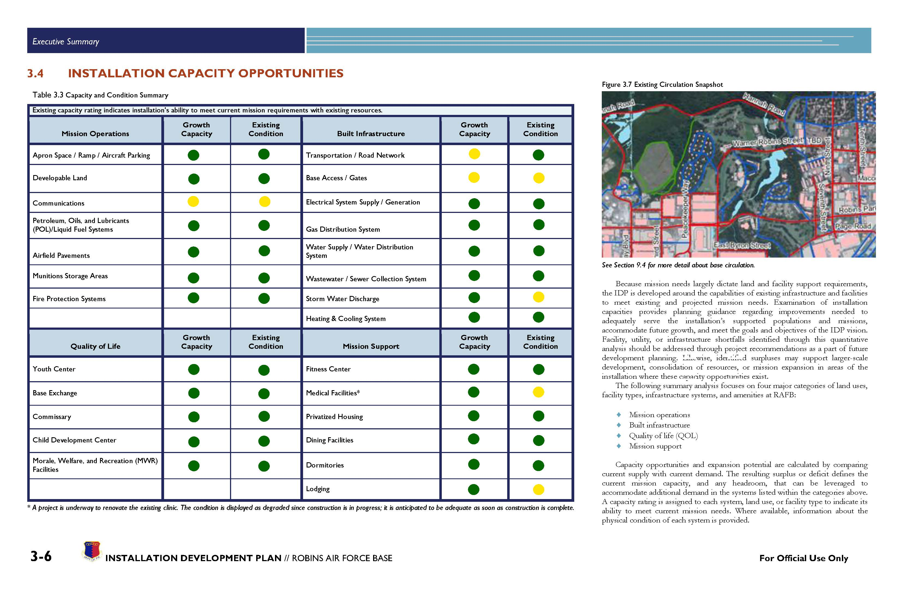
Existing Conditions and Growth Capacity
“The Installation of Excellence … The Place to Live, Learn, Work and Play”
Notes:
This chart identifies those areas where improvements are warranted in order to maintain or sustain the base’s mission handling capability into the future. No critical needs were identified but those shown as yellow here are areas that need to stay near the top of our priorities for improvement.

Slide 18
Developable Land
53.90 Acres
161.19 Acres
113.38 Acres
15.17 Acres
“The Installation of Excellence … The Place to Live, Learn, Work and Play”
Notes:
One of the major opportunities the IDP addressed was the availability of land cleared of significant constraints and suitable for new construction. It does include some paved spaces if they were deemed as being expendable and some demolition sites if the facility is already on the list..
Two of the areas did not contain any significant developable parcels. These were located on the east side of the base where the swamp is and there were a large number of constraints such as wetlands.
The next slides will provide a little clarity on the available parcels in the other 4 districts

Slide 19
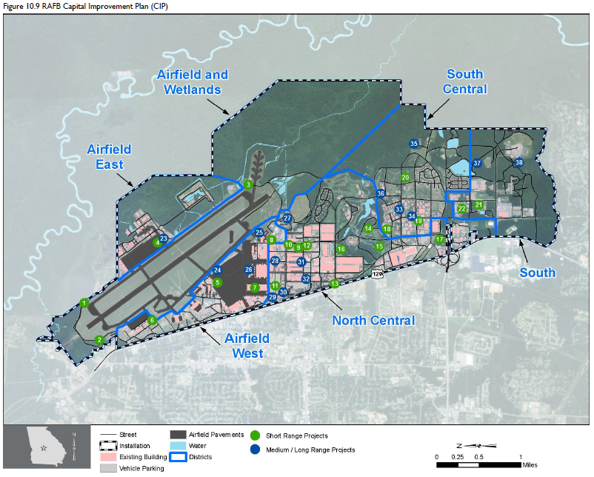
19
Notes:
The numbered circles on this map provide the locations of our near-term and future projects. As you can see, they are scattered through out the entire installation to meet the needs of our Mission Partners.
The next set of slides provide a listing of those projects identified here.

Slide 20
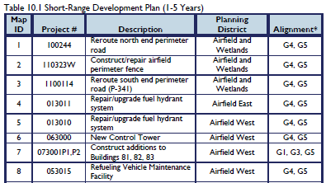
Near-Term Requirements
“The Installation of Excellence … The Place to Live, Learn, Work and Play”
Notes:
This represents some Road work, Building Additions and a few possible new construction projects. Most of these projects are the larger scale Military constructions or MILCON projects. MILCON projects, except for a small amount of smaller unspecified projects, are line item by Congress and in the past these have been becoming fewer and fewer. This means that much in our near term plans will be pushed out to future years.

Slide 21
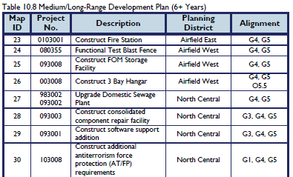
Long Term Requirements
“The Installation of Excellence … The Place to Live, Learn, Work and Play”
Notes:
The next two slides provide our longer term vision based on current requirements
Most of these long term requirement are part of our future MILCON program

Slide 22
78 CEG IDIQ Contracts (Value of $287M/5-yrs)
Contract Date Exp Dollar Limit
AE Design Services 8(a) 2019 $4M
Carpet/Flooring* 2015 $5M
Custodial Basewide 2019 $24M
Grounds Maint 2019 $8M
Mech/Elec 2018 $45M
Paint 2016 $7M
Pavements 2017 $30M
Recycling* 2015 $10M
Refuse* 2015 $10M
Roofing 2017 $9M
SABER** 2016 $50M
BOPEC D/B*** 2018 $45M
AE Environmental Services 2015 $40M
* New contract in process
** SABER (Simplified Acquisition of Base Engineer Requirements)
*** BOPEC D/B (Base Operational Program Execution Contract Design/Build)
“The Installation of Excellence … The Place to Live, Learn, Work and Play”
Notes:
One other item that may be of interest, this is not part of the IDP is our IDIQ Contract List.
These Indefinite Delivery, Indefinite Quantity or open ended contracts, when they become available are typically announced on the federal business opportunities or fbo website. Any contract that is let by the base for competitive bids are announced on that website. Some of these such are mandated for special programs.

Slide 23
Planning Office Contact
Terry Alan Landreth, P.E.
CE Planning Office Supervisor
505 Page Rd, B280
Robins AFB, GA 31098
(478)327-2910
DSN: 497-2910
FAX - (478)-926-6939
FAX - DSN-468-6939
terry.landreth@us.af.mil
“The Installation of Excellence … The Place to Live, Learn, Work and Play”
Notes:
And here is my contact information for reference

Slide 24

Discussion/Questions
The Installation of Excellence...The Place to Live, Learn, Work and Play"
Notes:
Thank you all for your time and attention. Are there any Questions?

